Slide 1
Signal Flow Framework

Slide 2
Requirement
Minimal complexity, Easy to use
Extensibility
Reusability
Loose coupling

Slide 3
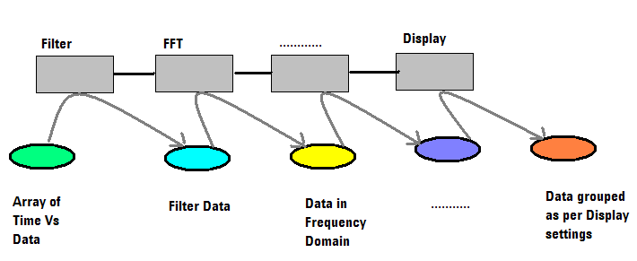
A typical Signal Analysis based application
Different processing blocks connected in a preconfigured ways.
A chunk of data flows from blocks to blocks (DataBlock)
Blocks do some processing on data .
Blocks may have state, or may act as stateless blocks.
Blocks may take action synchronously/Asynchronously
Thread safety will be the responsibility of block itself.

Slide 4
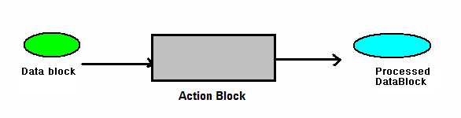
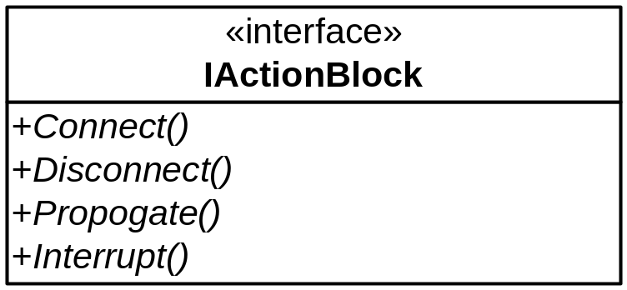
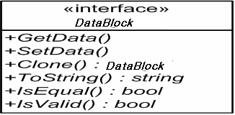
A typical Signal Analysis based application ……
Action block do processing on signal and transform it into more meaningful form
DataBlock flows from Action blocks to blocks and get transformed as per requirement
Action blocks can be connected in sequence to produce a desire result.
Order of Action blocks in a sequence is fixed.
Action Blocks need to reconfigured for initialization settings.

Slide 5
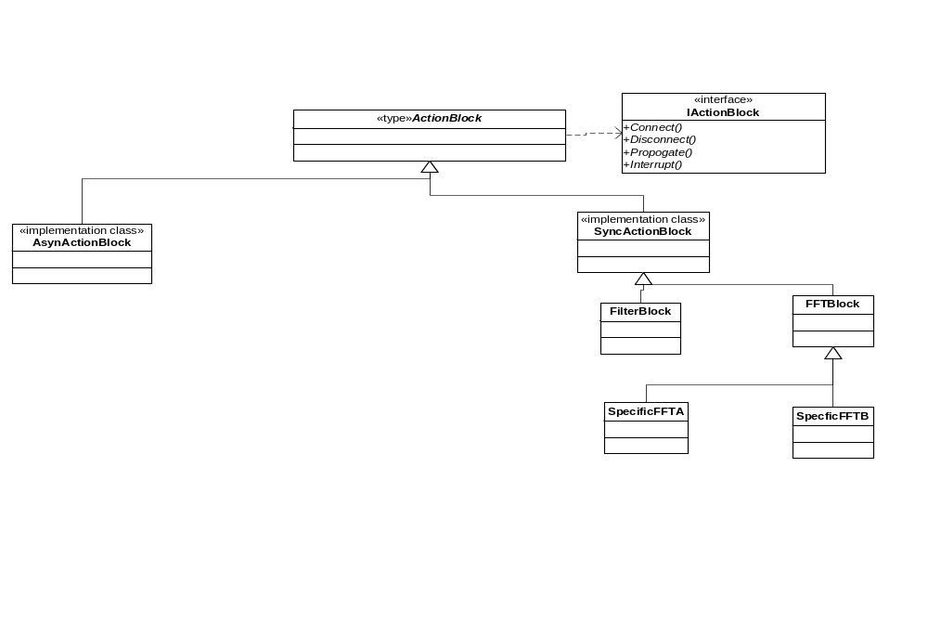
Signal Flow Class Association Diagram

Slide 6
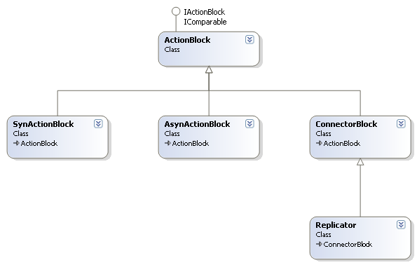
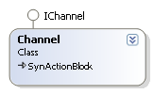
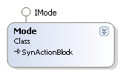

contd…
Signal Flow FrameWork Library / DLL
FrontPanelProto Application
Data flows in form of DataBlock
DataFlow will actually flow from channel to mode and mode to view
Actual measurement will be done in mode, results will be added to DataBlock object
Intermediate results are thus available at any time via DataBlock object
contd…

Slide 7
contd…
DataBlock
DataBlock
ActionBlock
ActionBlock
ActionBlock
Channel
Mode
View
Channel.Propogate()
Mode.Propogate()
DataBlock (containing raw data)
DataBlock (containing mmt result as well)
DataBlock Changes At Each Step
<RawData>, < ArrayList >
+
<WidowedData>, < ArrayList >
+
<FFTData>, < ArrayList >
+
<HarmonicValue>, < int >
Info from used added to DataBlock
<HarmonicFreq>, < double/float >
<HarmonicNo>, < int >
Windowing
Windowed data added to DataBlock
MEASUREMENT LIBRARY
FFT
FFT data added to DataBlock
Derived from
Harmonic
Calculation
Function call
Harmonic value added to DataBlock
Data Flow

Slide 8
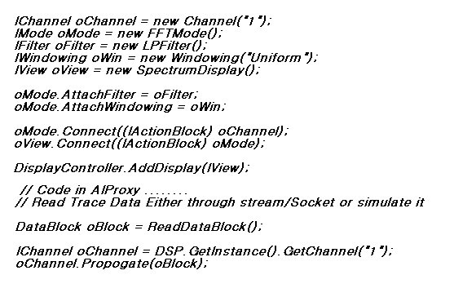
Easy to Use…..

Slide 9
DISCUSSION
Q & A

Slide 10
Back up slides

Slide 11
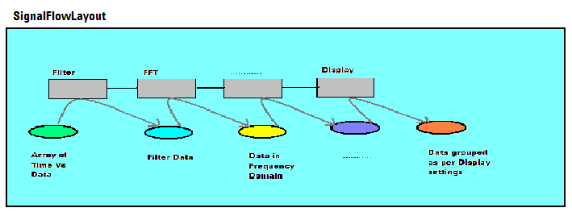
SignalFlowLayout
Responsible for maintaining the thread safety required for GUI based control and back end processing components.
Single point of contact to broadcast an particular control events to all blocks of that particular path, ex. INIT event to initialize all block for their base configuration.
Point of contact for sending any specific control events to a block.
  RESET, INIT, START OF DATA, END OF DATA, TRIGGER
Each block need to register themselves with signalflowlayout for any particular events.

Slide 12
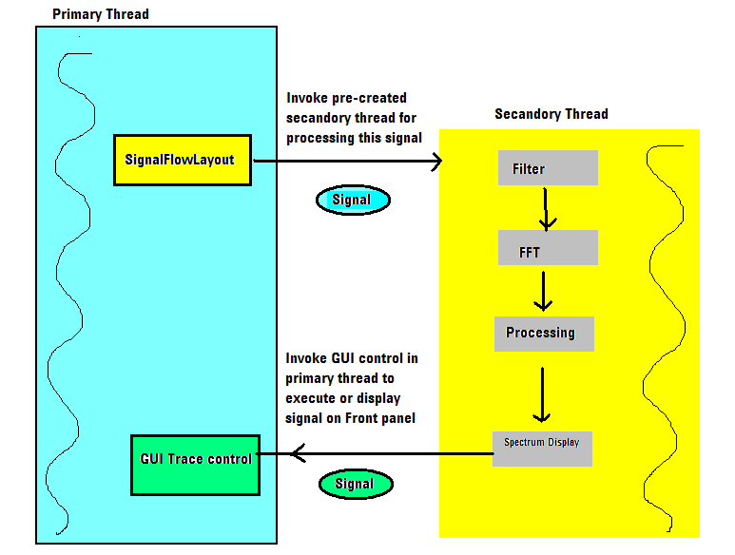
Threading and SignalFlowLayout
Take care thread affinity required for GUI controls.
WinCE equally divide time between threads, does not have any upper limit of time slice per application.
Create more thread to get more hold of CPU.
Primary thread will handover the signal object to SignalFlowLayout, which transform the signal through its connected blocks.

Slide 13
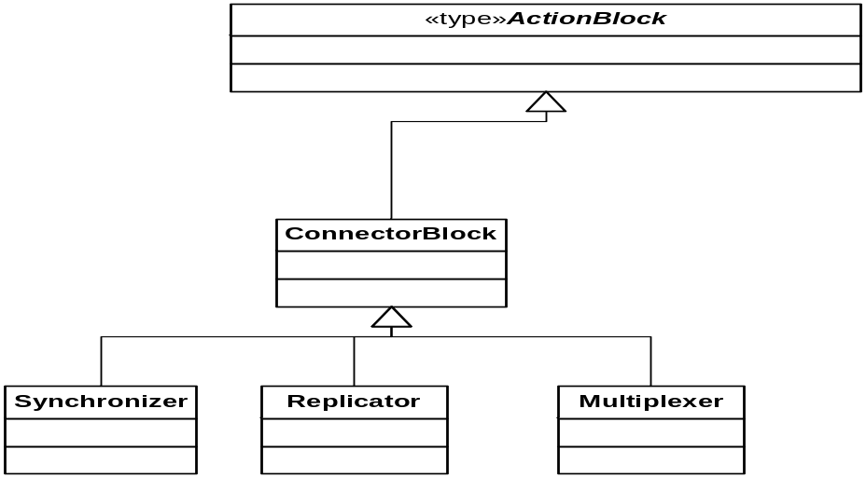
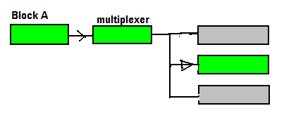
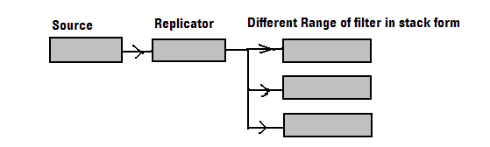
Connector as a processing block
DataPath output policies are treated as a processing blocks.

